Slide 1
IonTuition
Not Your Everyday Benefit
Employee Financial Wellness
Hire & Retain the Best
Grow your Talent Pool
Confidential and Proprietary to IonTuition, Inc

Slide 2
Solutions for Employers
RECRUIT
Recruiting talent pipeline
RETAIN
Financial & Mental Wellness
RESKILL
University Partners

Slide 3
IonTuition is NOT Your Everyday Benefit Program
Employee Student Loan Repayment Assistance
Custom contributions, direct payroll deductions
Online connections to Federal student loan Servicers
Concierge counseling 5 days per week
App-based Access to Mental Health Counselors with Rapid Response Times
IonTuition provides mental health counselors via its META Teletherapy platform to your employees
Appointments for video counseling sessions in less than 6 hours, generally 1 hour
Recruit New Hires Before They Graduate
Connect with IonTuition’s colleges through our CoverCloud network
Upskill and Re-skill Your Employees
Customize your own programs with our university partners
Provide financing to retrain your employees

Slide 4
IonTuition Key Services
Recruit
IonTuition offers partnerships with an online university before they graduate. Talk to us about our affiliate partner, CoverCloud, to hire the best, FIRST!
Recruit College Students Before Graduation
Retain
Valid through 2025. Employers can pay $5,250 per employee/year. Requires employers to set up program design. Program design is key for impact.
Tax-free Student Loan Paydown or 401K Match
Retain
Access to a marketplace of mental health providers for private, secure chat, voice, and video counseling sessions
META Teletherapy
Reskill
Upskill or Reskill your employees with online or onsite programs. Pay only part of it by participating in an ISA with IonTuition’s partner lenders.
Upskill, Reskill Training Programs

Slide 5
Federal Student Loan Chaos Continues into 2023
The GAO said Education Department officials "expect it will still be a challenge to motivate borrowers to resume repaying their loans after over two years of payment inactivity.” [GAO Report 22-10529, Jan 2022]
37 Million Americans will Begin Repayment May 2022
– Are my employees ready for 2-hour hold times with Federal servicers?
Retaining My Employees
– How do I implement education assistance benefits to retain my best employees?
Training My Employees
– How can I finance reskilling or upskilling for my workforce without adding to their debt?

Slide 6
Employees Want More Financial Wellness
Student loans are the biggest burden carried by Millennials and Gen Z, the largest population of employees
In 2021, 88 percent of employees have used employer provided financial wellness benefits when provided, compared to only 51 percent in 2012
63 percent suffering from financial stress
Source: PwC’s 10th annual Employee Financial Wellness Survey, Nov 2021

Slide 7
Primary Benefit – Student Loan Management and Repayment Assistance
Tools to Relieve Education Financial Stress
Student Loan Repayment Planning Calculators
Student Loan Contribution Programs
Online connections to student loan Servicers
Family Accounts
Monthly Reporting
Concierge Counseling 5 Days Per week
College Research and Planning

Slide 8
IonTuition Self-Service & Concierge Advisory For the Entire Student Loan Lifecycle
IonTuition is the only benefit to help borrowers at all stages of repayment
PARENT BORROWERS
FRESH
GRADS
STRUGGLING BORROWERS
HEALTHY REPAYERS
College planning
Family accounts
Loan platform & alerts
Repayment calculators
Concierge advising
Default aversion
Refinancing
Contributions
Concierge, VIP-level Loan Counseling

Slide 9
Offer a “Beyond Coaching” Counseling Experience
IonTuition is audited and attested as a Third-Party Servicer for working with Federal student loan borrowers
Largest in-house call center dedicated to student loan repayment with room to scale
Priority phone lines into Federal servicers
Trained, Certified Financial Education Instructors
Available daily starting at 7am CST via phone or webchat
88% of concierge counseling interactions result in repayment optimization
IonTuition offers the smoothest, online, direct connection to all Federal Student Loan Servicers, FFELP lenders and many large Private lenders

Slide 10
Unmatched Experience in Education Assistance
600,000
$10.9 BILLION
4.7 MILLION
37+ MILLION
average number of calls placed monthly
in resolutions for student loans
students in service
minutes on the phone helping borrowers
Supplemental Third Party
Student Loan Servicer
98% Satisfaction Rating

Slide 11
Proudly Serving Employers Of All Kinds
~1 million eligible lives
300,000 registered users
30.5% return rate

Slide 12
IonTuition is the Only Full-Service Solution
Competitive Differentiators | Refi-Focused Providers | Contribution-Focused Providers | IonTuition
Automated Loan Import via Data Aggregator | ☑ | ☑ | ☑
Basic Repayment Calculators | ☑ | ☑ | ☑
Contribution Program | ☑ | ☑ | ☑
Refinance Marketplace | ☑ | ☑ | ☑
Audited 3rd Party Student Loan Servicer under HEA |  |  | ☑
Assistance for defaulted borrowers |  |  | ☑
Family Benefit |  |  | ☑
In-house Counseling Operations Built for Scale |  |  | ☑
Objective Refinance Guidance |  |  | ☑
Operating in Azure Government Cloud |  |  | ☑
College Selection & ROI Scorecard |  |  | ☑

Slide 13
IonTuition Demo
ION provides a comprehensive student loan benefit, addressing the needs of employees across the entire loan lifecycle

Slide 14
Easy Implementation
1 | Requirements | Plan design and strategy Participant touchpoints Business processes
2 | Communications | Launch communications and engagement planning Monthly calibration calls Annual communications strategy review
3 | Configuration | Plan activation Call center preparation Quality assurance testing
4 | Interfaces | Census, enrollment and contribution file development SSO Benefits portal integration
5 | Launch | Welcome email Ongoing engagement communications Quality control and production validations

Slide 15
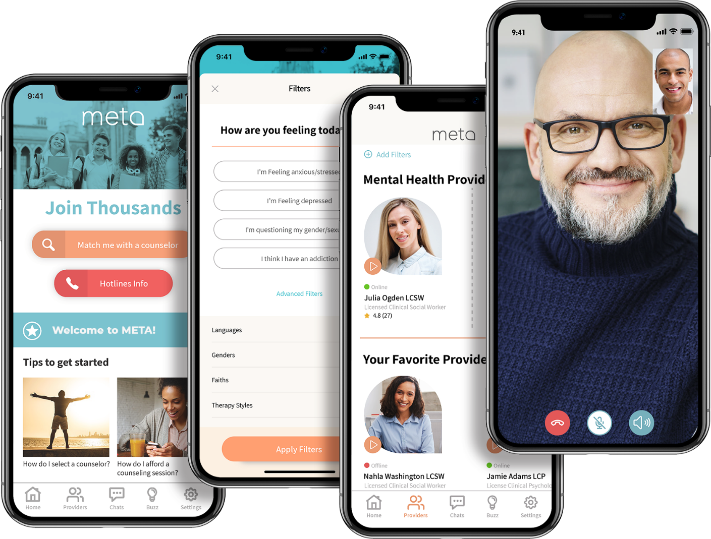
Additional Benefit – Mental Health App & Counseling
Support Employee Mental Health
Android & iOS mobile app
Access to a marketplace of providers, freedom to choose any counselor
Most providers respond in under 1 hour
Chat, voice, and video therapy sessions
Insurance co-pay, self-pay, or employer can sponsor paid-sessions
HIPAA compliant; private and secure platform

Slide 16
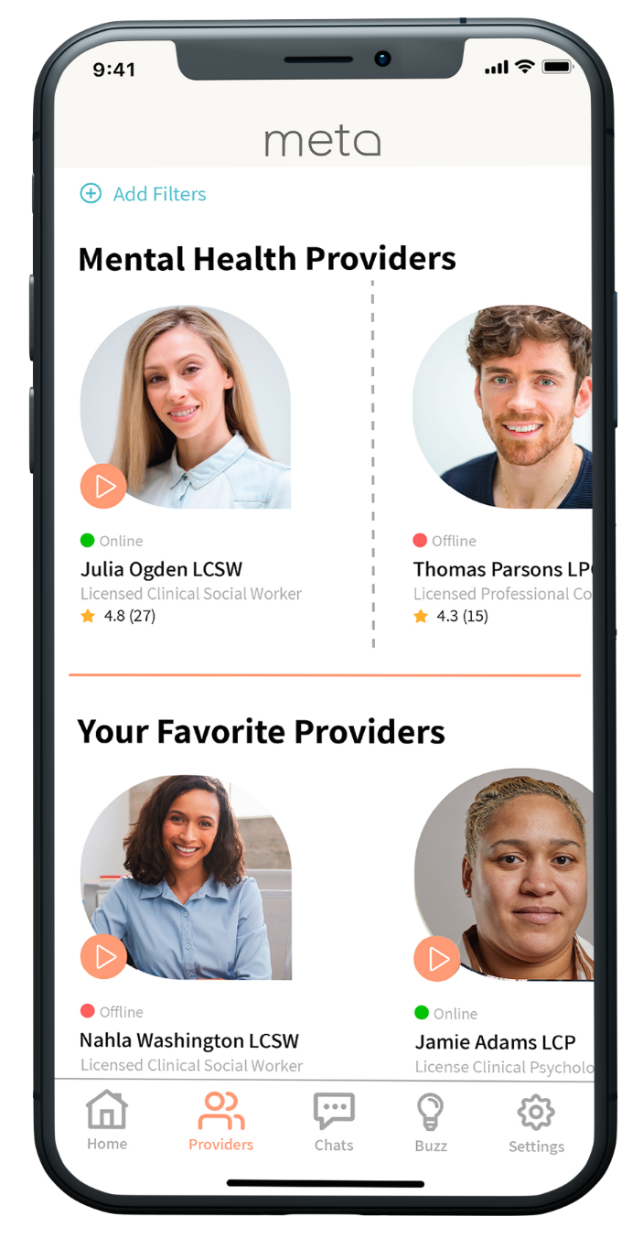
Trusted Marketplace of Providers
600+ Licensed Professional Counselors, Family Therapists, Social Workers, and Psychologists
All providers are personally vetted and must pass thorough onboarding process
Availability during days, evenings, and weekends – accepting new clients
Responsive and Committed
60,000 hours of online availability in 2 years
Average provider rating is 4.9/5.0
Majority of providers have a typical response time under 1 hour
Diversity and Inclusion
Multiple ethnicities, faiths, and languages represented
Wide range of specializations and therapy styles

Slide 17
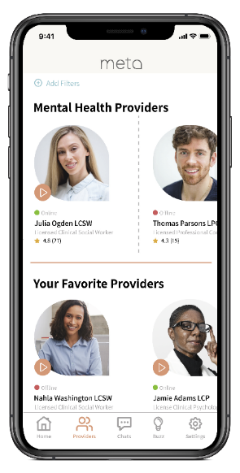
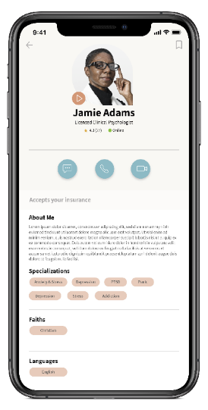
Enjoyable User Experience
SEARCH
SELECT
ENGAGE
Access
Register in 2 minutes
Choice
Select META counselor
Connect
Private chat, video, voice sessions

Slide 18
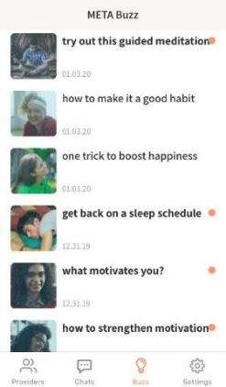
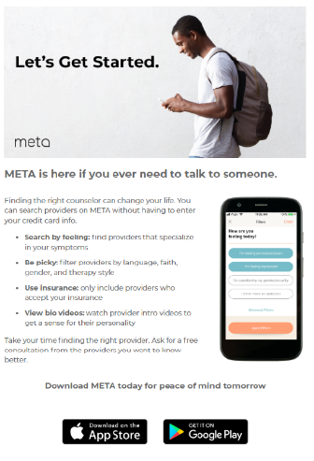
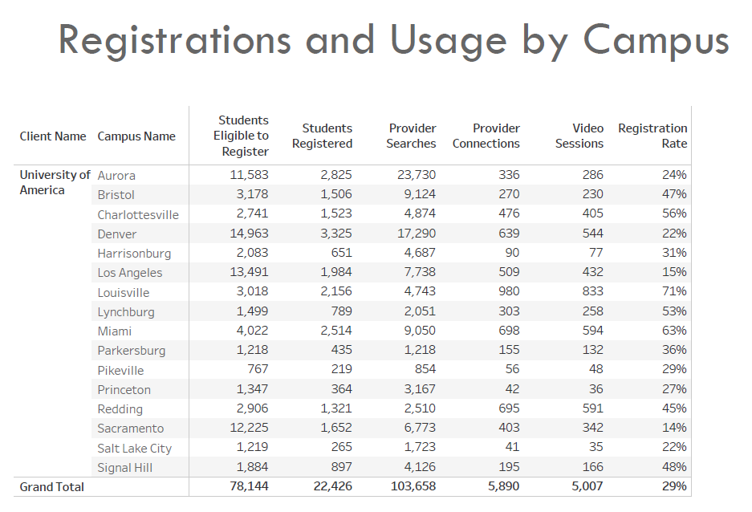
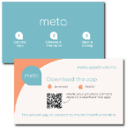
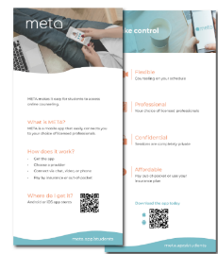
More Than Just a Link On Your Benefits Page
Marketing Support
Physical & digital collateral
In-app articles and notifications
Employee Assistance Program integration
Monthly Reports
De-identified and Aggregated, per HIPAA
Total Registrations & Counseling Sessions
Search & Chat Activity
Company-paid sessions for employees in-need

Slide 19
Brent Givens
Senior Vice President
847-873-2167 (M)
Bgivens@iontuition.com

