Slide 1

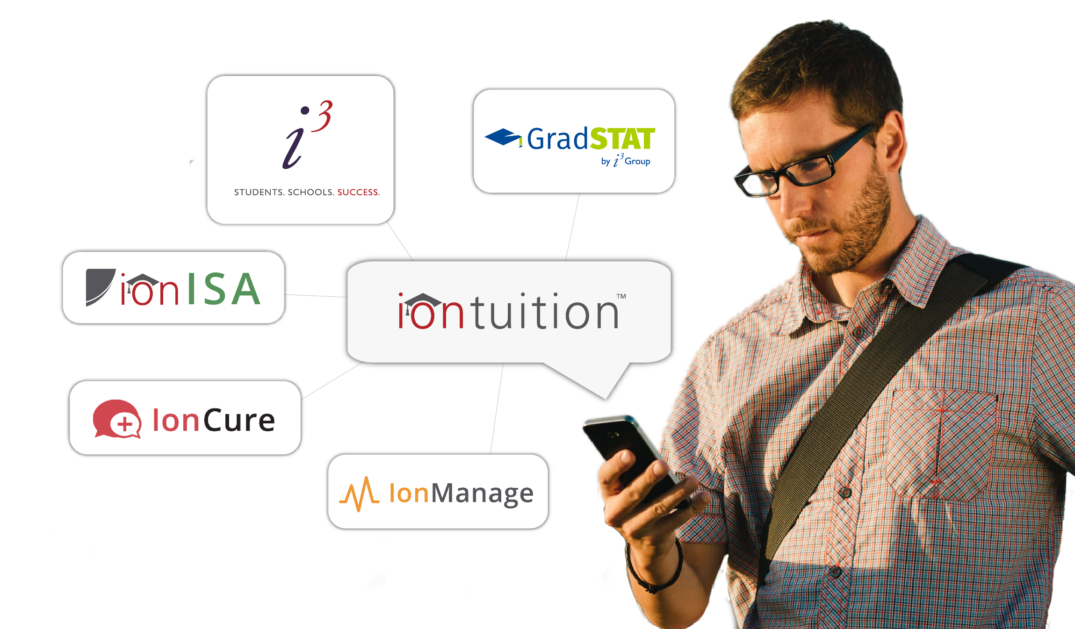
Full Lifecycle Loan Servicing
Improving student success

Slide 2


Helping Students Succeed for Over 10 Years
The only service helping students and schools at each stage of repayment
CAREER
PURSUIT
FRESH
GRADS
STRUGGLING
BORROWERS
HEALTHY
REPAYERS
In-school Proactive Servicing
Income Share Agreements
College Lead Generation
Loan Platform & Alerts
Repayment Calculators
Employment Data Collection
Concierge Advising
Default Aversion/Recovery
Unbiased Refinancing Guidance
Employer Benefits/Contributions
Concierge-Style Loan Counseling

Slide 3


Student Loan Servicing and Default Aversion
The Industry’s Most Experienced Concierge-Style Advisors
Served 3.8+ million students avert delinquency and default at 1,250+ campuses in the US
Proven history of reducing cohort default rate (CDR) through proactive outreach and expediated default recovery methods
  Grace/In-school Period Outreach
  Current Repayment Outreach
  Delinquency and Default Outreach
Counselors quarterback conference calls between servicers and borrowers through priority lines which bypass wait times and improve outcomes
Proprietary skip tracing process ensures counselors contact with the right party and spend less time dialing and more time counseling
Dedicated inbound phone lines and live chat through portal.iontuition.com
New for 2022: Web-to-Lead Generation Service – Use our counseling center so student prospects visiting your school’s web page can connect with a live person and their information can be collected and handed off to your recruitment team

Slide 4

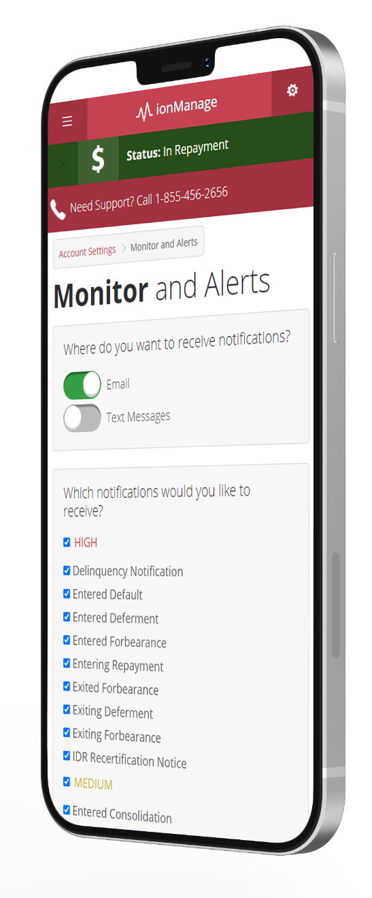








portal.IonTuition.com – Self-Service Platform
Student Loan Repayment Platform
Borrowers and their families use portal.iontuition.com to …
Avoid student loan default
Lower monthly payments or save money on interest
Connect with IonTuition student loan counselors and student loan servicers
portal.IonTuition.com delivers self-service tools with live counselor support…
Track repayment of all Federal and private student loans
Explore repayment options including income-driven plans and refinancing
Receive customized alerts and notifications

Slide 5

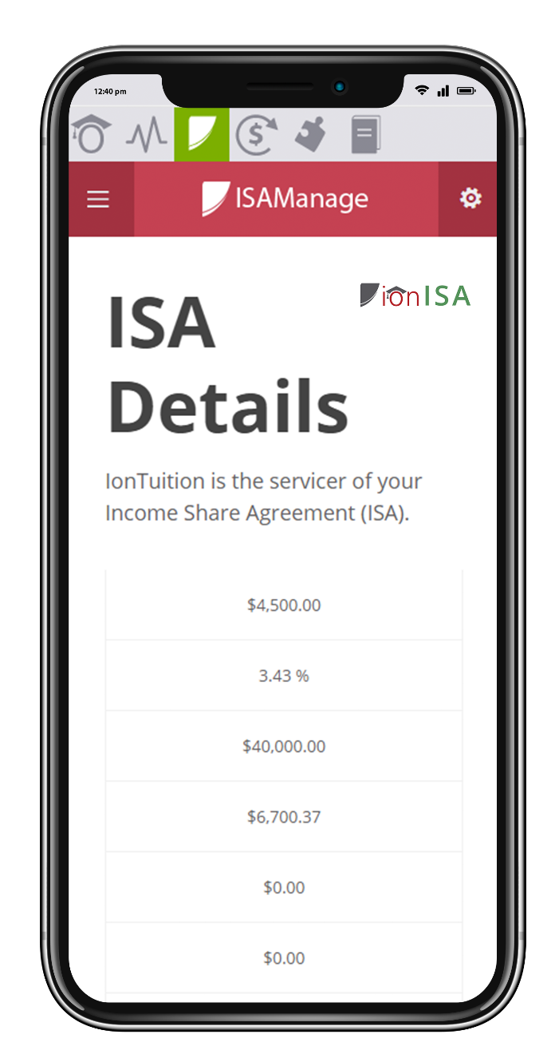
IonISA – Income Share Agreements
First Platform for Employers, Schools, Funders, and Students
IonTuition ISA servicing comprises of…
Bank-based model with compliant origination overseen by Blue Ridge Bank, national regulators
In-school, Grace and In-Repayment Servicing
Breach of contract cure through innovative, loan rehabilitation-like programs
Students manage their ISA payments alongside their student loan repayment via portal.iontuition.com
Mobile-friendly interface
Instant access to all ISA paperwork and contact information
Employment and networking support
End-to-end ISA servicing – from origination to completed obligation

Slide 6


GradSTAT – Graduate Employment Data
Accurate Employment and Salary Data on your Alumni
Colleges use GradSTAT to…
Maintain accreditation
Meet regulatory requirements
Support research/program integrity
Promote school success
Our outreach has the highest response rates in the industry…
Minimum of three phone outreach attempts per week
Email blasts pushing survey completion
Inbound/outbound contact center
Receive student-level data instead of aggregated data

Slide 7

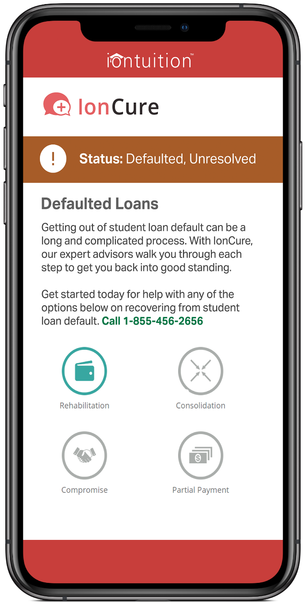
IonCure – Default Recovery Service
Recover from Student Loan Default
Borrowers in default use IonCure to…
Return to a good-standing loan status
Reinstate their eligibility to borrow
Ensure their rehabilitation is completing correctly
Avoid re-defaulting in the future
Once again, our counselors prove their worth by…
Managing all paperwork necessary to remove default status
Facilitate communication with servicers and private collection agencies
Track process all the way through and move borrower into a sustainable repayment plan

Slide 8

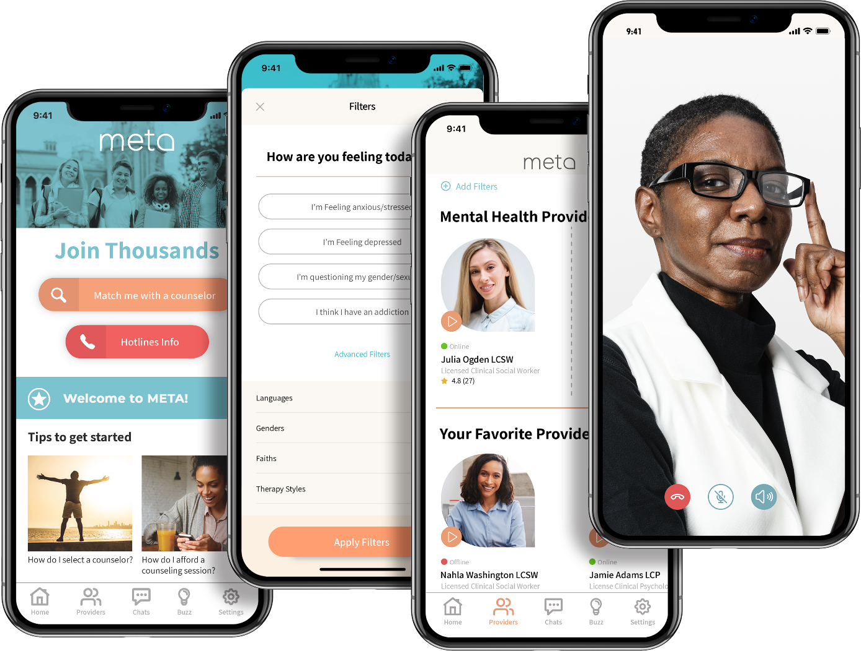
META Teletherapy – Student Wellness Platform
Connect students to a marketplace of counselors
Colleges implement META Teletherapy to…
Reduce wait times for counseling sessions
Support out-of-state and online students
Increase access to diverse counselors
Augment their existing counseling center
Students use META to…
Connect with a counselor of their choice for private, secure session
Receive emotional support all year long, even over breaks
Avoid the stigma of mental illness by using a private option
Receive counseling sessions evenings and weekends

Slide 9

Let’s Connect
Brent Givens
Senior Vice President
847.873.2167
BGivens@i-3group.com

