Slide 1


Full Lifecycle Servicing for ISA
Improving student success
Notes:
Teal green and dark blue in logo not working – go with primary colors similar to Ion (send updated logo to Karthik)
Title edit – comprehensive statement not working – consider end to end; wing to wing; complete; origination to repayment; must encapsulate entire iSA lifecycle and show difference
Helping and giving tag needs to be active voice

Slide 2

We Know Student Servicing – at Large Scale
300+ Total years of senior team experience in federal student loan programs | 2.1M borrowers serviced in the last six years | $5B+ in defaulted student loans rehabilitated
#1 ranked contractor on all scorecards for all student loan portfolios | 2.6M+ hours on the phone counseling borrowers | 15 year company focus on the student loan lifecycle
$100M Increased data matching from Treasury Offset Program for FSA and State Tax Agencies | $42B student loans processed | 1.5M+ borrowers entered into optimal repayment
98% Satisfaction Rated “satisfactory” or “excellent” on 52,000 customer surveys | 136M Payment transactions processed (2012 – present | 600K calls placed each month
Notes:
Color consistency – reconcile dark blue, purple, etc. – revisit palette

Slide 3

Income Share Agreements Present New Opportunities & Challenges
Regulatory Framework
Is it still a Loan, couched differently?
Will it reduce Federal student loan debt?
What are key differences between ISA and IDR?
Best Outcome Delivery for Students through ISA
Limited Servicing resources
Zero success support mechanisms in marketplace today
Risk Cannot Reside Only with the ISA Fund
Universities can share risk and reward
Employers and ISA Alumni can participate in the future

Slide 4
ISA Program Design
Customized pricing calculators for schools that want to sell originated ISAs
Minimizing adverse selection:
Early payment options that attract students that are more likely to pay back
Differentiated dynamic ISA pricing based on current employment status of individuals, so they are more likely to enroll
This is very relevant to high quality students as well!
Dartmouth Tuck MBA student survey (2018) shows which aspects of ISA students cared about the most:
It has to be cheaper than Grad PLUS loans | 71.43%
It has to be cheaper than private loans | 80.95%
Early repayment options compared to PLUS and private loan options | 66.67%
Total payment cap | 57.14%
Role of credit score in getting financing | 14.29%
Income level below which payments are forgiven | 28.57%
Other | 4.76%
Notes:
Bring up pricing
Anticipated Questions
-Typical investor IRR – 10% is reasonable (10-12%); many investors talk about 15%
-Cap – 1.2x to 2x (school dictated; higher end to maximize return; 1.5x is a moderate to control student cost)
-Fund performance at industry level: blue skies claims likely aren’t including those not repaying due to un/under-employment; delinquency happens so we foster the skills and provide tools to navigate that; per Vemo, MentorWorks has best performing portfolio they’ve seen
Disbursement interval – depends on fund versus school capital (Zovio = fund; Fullstack = school funded; but funds may flow back to overarching/Zovio fund); talking point is that we have multiple disbursement options – more intervals controls risk and aligns to tracking student performance
Ceannate short-term (origination management and servicing) versus long-term (funding ISAs via Ceannate-sourced capital; perhaps via managing multiple funds); mentorworks has investment connections – they will speak to that here

Slide 5



We Support Your Student From Beginning to End
Repayment
Should I prioritize my Federal Student Loan payment above my ISA payments?
Can I make my payments online?
Can I prepay my ISA early?
Student Engagement and Onboarding
How does a ISA benefit me?
What's the difference between an ISA and a Student Loan
Application & Origination
How do I apply for an ISA?
What are the requirements?
Deferment
I’m unemployed and can’t make my payments…
How do I apply for a deferment?
Disbursement
Will this be disbursed before I start classes?
How much is my ISA?
Federal Student Loans
ISAs
Private Loans
Delinquency
I’ve fallen behind on my payments.
How do I get back to current status?
In School
How do I manage my ISA?
I fell below the full time status now what?
Breach of Contract
Is this effecting my credit?
How can I get back in good status?
In Grace
How much are my payments?
I’m still unemployed and don’t know what to do…
Obligation Satisfied

Slide 6
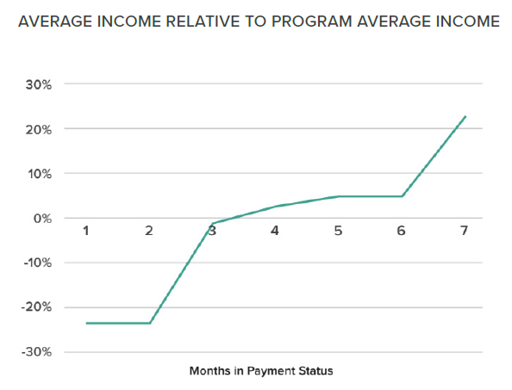
During School: Qualifying for an Income-Share Agreement
Proven Underwriting Process
Students are pre-screened and qualified based on:
Personalized vetting process
Psychometric validation
Income assessment models based on experience/social networks
Credit history or outstanding delinquencies
Projected/current income
We have had strong outcomes.
Percentage of delinquent students: 0%
Percent of payment status ISA months current (not in deferment): 91.11%.
2019 current cash on cash yield on payment status ISAs: 12.4%
Funded students at:
Northeastern University
NU Level Data Analytics Program
Univ. of Mass, Boston
Univ. of Mass, Amherst
Columbia University
Ohio State University
NYU
UC, Berkeley
UC, Irvine
George Washington University

Slide 7
Broad Underwriting Criteria Options
Eligibility
No 60+ days past due currently outstanding on any payment
U.S. Citizen or Permanent Resident
Age of 18+ for all eligible states except Alabama (19+) and Nebraska (19+).
Minimum 2 years of academic history.
Core Underwriting
Positive psychometric assessment score using proprietary MentorWorks NonCog score model.
Predicted income using prior experience and social media using proprietary MentorWorks IncomeScore model.
Key post education interests: e.g., “Starting a company” or “Obtain further full time education”
Academic ability: GPA levels in UG
Academic trend: GPA trends in UG
Networking proclivity: LinkedIn connections.
Prior experience.
At least 3 months prior experience in off-campus job or internship.
At least 1 month prior experience in off-campus job or internship in a company with more than 200 employees.
Optional criteria
Minimum FICO score
No charge-offs or bankruptcies
No delinquencies in past 12 months.
Notes:
Don’t talk about Skills entity

Slide 8
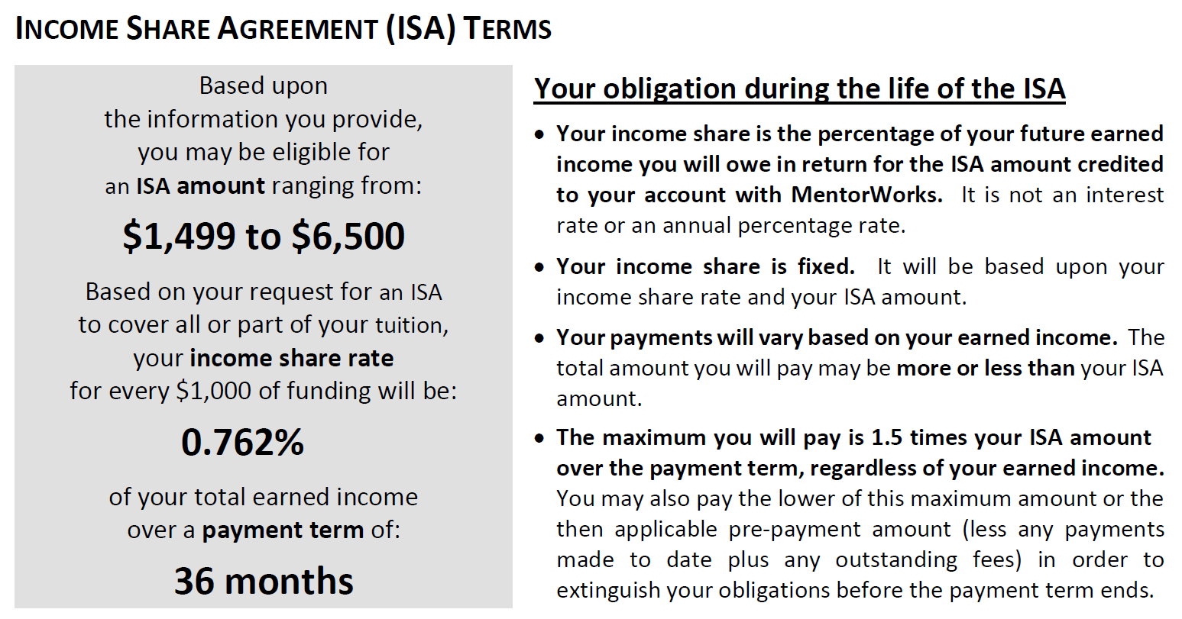
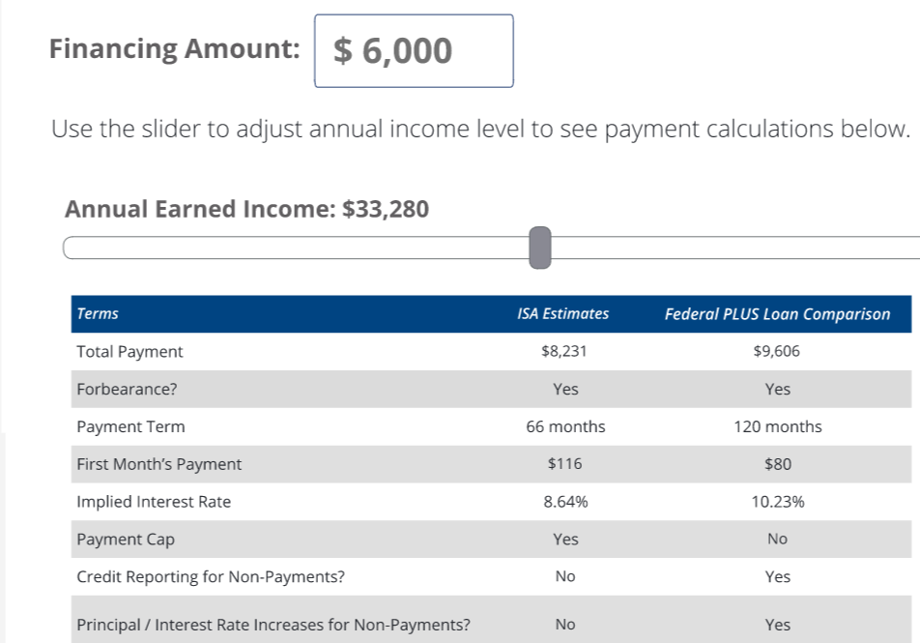
Clear and simple online calculator for students to understand program cost
Both online tools and dedicated counseling to help students understand:
ISA terms
Benefits and costs of ISA program
Comparison to loans
Notes:
Calculator screenshot (remove family access) alongside disclosure screenshot
Header – meets regulatory requirement in any state and jurisdiction; meets loan regulation requirements; consistent with TILA; point out Nelson Mullens value in that regard

Slide 9

With ION ISA, Your Student is Our VIP
Students receive concierge-level servicing, in-school and beyond
Financial wellness
Manage student debt from previous education
Budgeting tools
Career support:
Employer access for internships and jobs across multiple industries
Access to a community of mentors and alumni to get career support and advice.
Professional lifecycle career support: Support to reduce gaps in employment improve incomes
Investor risk reduction and student benefit Automated feedback between servicing and careers platform ensures continuous support to students as they need it.
Discount on ISAs for alumni to return as mentors and career advisors – “Pay it Forward.”
Notes:
Bullets and graphic for advisors; we’ll put in Advisor content and Karthik will add MW points

Slide 10

Ion ISA Provides Concierge Advisors – throughout the program
80 hours classroom training and 40 hours on-the-job training for new hires
Ongoing training delivered monthly, quarterly, and annually in 1-on-1 and group settings
Semi Annual Training and Examination is administered in the following areas:
Security Awareness
Fair Debt Collections Practices Act (FDCPA)
Family Educational Rights and Privacy Act (FERPA)
All Customer Service Managers are certified as Certified Financial Education Instructor (CFEI) through the National Financial Educators Council (NFEC)
Customer Satisfaction Surveys and internal Audit and Compliance “Scorecards” are used to identify “coaching and training” opportunities

Slide 11
Ion ISA’s Compliance Ensures Delivery of Quality in Service and Standards
Externally audited Third Party Servicer under Higher Education Act requirements set by US Department of Education rules
Comprehensive Compliance Management System, which ensures identification and resolution of potential issues.
Enterprise-wide independent oversight based on “tone at the top” principles
Professional Practices Management System (PPMS) Annually Assessed and Certified
Less than 30 Complaints since December 2016 on the CFPB Database company wide
Compliant with all State and Federal regulations including, but not limited to:
Risk Assessment
Compliance Training
Compliance Oversight
Fair Debt Collections Practices Act (FDCPA) | Unfair, Deceptive, or Abusive Acts or Practices (UDAAP)
Equal Credit Opportunity Act (ECOA) | Fair Credit Reporting Act (FCRA)
Fair and Accurate Credit Transactions Act (FACTA) | Service Members Civil Relief Act (SCRA)
Ion ISA’s General Counsel oversees all compliance and risk management activities and ensures employee training and performance delivery across all companies meet required standards

Slide 12
Scalable Technology Supports Best-in-Class Security
Application | Purpose
Microsoft Azure Government Cloud | - Provides Infrastructure as a Service (IaaS) - Ensures fastest performance, unlimited scalability, and highest availability - Operating expense with no refresh cycle vs. a Capital Expense with a refresh cycle - Lower Total Cost of Ownership (TCO) than premise-based architecture.
Virtual Servers, Terminal Servers, and SAN | - Leverages shared resources and economies of scale to reduce TCO and maximize efficiency - Increases speed of system deployment, decommissioning, and re-deployment - Establishes fixed costs as opposed to variable costs - Creates business flexibility - High performance, availability, and security - Cisco, Microsoft, EMC, IBM and Dell brands provide reliable performance, support, maintenance, and lifespan - Dialers and telephone systems are highly scalable and highly customizable.
RPG / DB2 / and/or Microsoft SQL / .NET | - Industry standard and open architecture for highest accessibility, ease of integration
Compliance Security Standards
FISMA / NIST
FedRAMP
PCI-DSS
SSAE 18 SOC I/II
FERPA

Slide 13
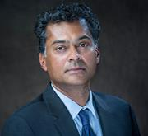
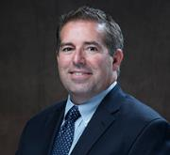
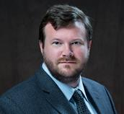
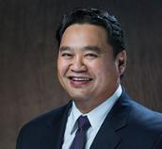


Ion ISA Team – Unmatched Experience in Higher Ed Finance Success
Balaji (Raj) Rajan
Brent Givens
Raj’s expertise spans education, technology and solutions, design, and development. He excels in self-directed, sustainable teams in creating new businesses
Brent has over 25 years of experience in student loan financial services industry. He held management positions at Career Education Corporation and Sallie Mae (16 years)
Mark Rowland
Joe Buscaino
Mark has worked extensively in nearly every operational area of Ceannate in his 13 years with the organization, and he uses that experience in developing systemic solutions to process enhancement and business challenges
As VP of Operations, Joe optimizes performance to advance company operations, drawing on his extensive experience throughout the industry.
Karthik Krishnan
Micha Sabovik
Karthik is an Associate Professor of finance at Northeastern University and an angel investor with Launchpad Venture Group. He has seven years of experience in teaching and research in the areas of entrepreneurship and education finance. Karthik is also a thought leader on education financing having published various articles on the subject. He has mentored and helped various students land meaningful internships.
Micha has nearly 25 years in higher education, leading teams of all sizes in the areas of student services (graduate and undergraduate), enrollment, career services & strategies, business development, marketing, mentoring, financial aid and social media content creation. Micha also teaches a graduate-level social media course at Boston University.

Slide 14

Contact Us
Brent Givens SVP, IonTuition
847.873.2167 bgivens@iontuition.com

