Slide 1


IonCURE
Powered by IonTuition.com
Finally, an easy, painless way out of student loan default
Confidential and Proprietary to IonTuition, Inc.

Slide 2
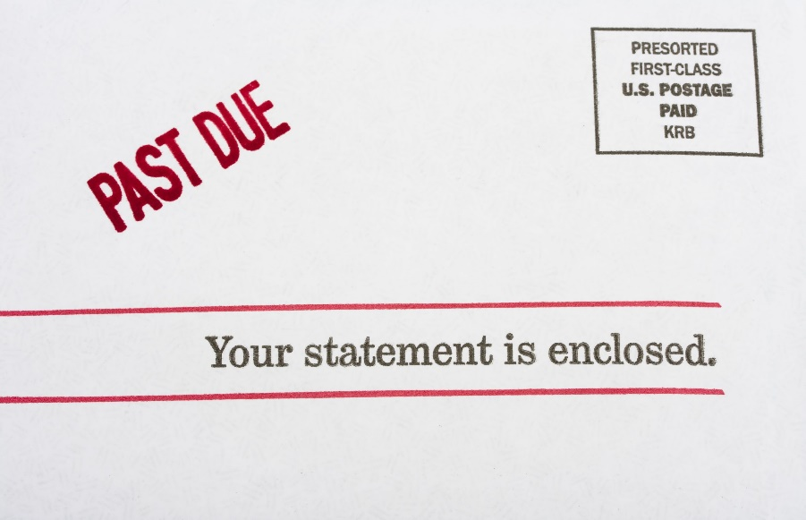
Student Loan Default by the Numbers
By the time you finish reading this slide, another person will default on their student loan
10.2 MILLION (1 in 5)
- Federal student loan borrowers are in default
FEDERAL STUDENT AID
~1 MILLION
- student loan borrowers default each year
40%
- of student loan borrowers are expected to default by 2023
2 MILLION
- are 90+ days delinquent on Direct loans
88.23%
- of defaulted borrowers have not made a payment in over a year
10.8%
- default rate among students who graduated or left school

Slide 3


Great Way to Remove Default Now
Student loan payments and interest accrual have been suspended till 2021 and “maybe beyond that” according to President Joe Biden.
This is a great opportunity to remove default during this period.
IonCure can cure default on their Federal loans
Become eligible for new student loans to complete education or go back to school to gain new skills
Get into a “current status” and potentially improve credit ratings
Avoid collection agency interactions

Slide 4
Current Default Cure Process is Clunky, Complex and Borrower Must Work with Collection Agencies
Defaults on Federal Student Loan
Account referred to Private Collection Agency (PCA)
PCA 1
PCA 2
PCA 3
PCA 4
PCA 5
PCA 6
PCA 7
PCA 8
PCA 9
PCA 10
PCA 11
PCA 12
PCA 13
PCA 14
PCA makes contact with defaulted borrowers via phone calls and snail mail (no web)
Must talk to PCA
accepts compromise/settlement?
eligible for rehab?
eligible for consolidation?
currently employed?
NO
NO
NO
YES
YES
YES
YES
Pays off debt
Enter Payment Plan
Enter Payment Plan
Wages garnished
Rehab agreement letter via mail
Statements via mail
IRS tax info
Makes 9 payments to PCA
Account recalled by FSA
Enter Payment Plan if needed
Consolidate into new loan with new interest rate
New Loan principal balance will be higher than current defaulted loan
New servicer
Contacts borrower

Slide 5
IonCURE – Smooth, Online, Convenient Concierge
Borrowers load their loan information into IonTuition and the platform refers users with defaulted loans to enroll into IonCure. Once enrolled, a concierge loan advisor will contact them to begin process or defaulter can manage process online.
STEP ONE
STEP TWO
STEP THREE
Register on iontuition.com
Load loan information
Review options online
Select repayment option online
Work with ION’s concierge 1-on-1
Submit docs online
Await approval
Monitor progress
Connect with new servicer when loan is cured
Manage new loan on IonTuition at no cost

Slide 6
Our Experience with IonCure
53% of borrowers select rehabilitation | up to 6 qualifying monthly payments needed to reinstate Title IV Eligibility
38% of borrowers enroll in consolidation | up to 90 days to get consolidation completed, some can be quicker
9% of borrowers negotiate settlements, pay balance in full, or other payment arrangement | based on ability to pay

Slide 7
We Know Student Loan Servicing – at Large Scale
300+ Total years of senior team experience in federal student loan programs | 2.1M students serviced in the last six years | $5B+ in defaulted student loans rehabilitated
#1 ranked contractor on all scorecards for all student loan portfolios | 2.6M+ hours on the phone counseling students | 15 year company focus on the student loan lifecycle
$100M Increased data matching from Treasury Offset Program for FSA and State Tax Agencies | $42B student loans processed | 1.5M+ students entered into optimal repayment
98% Satisfaction Rated “satisfactory” or “excellent” on 52,000 customer surveys | 136M Payment transactions processed (2012 – present) | 600K calls placed each month

Slide 8
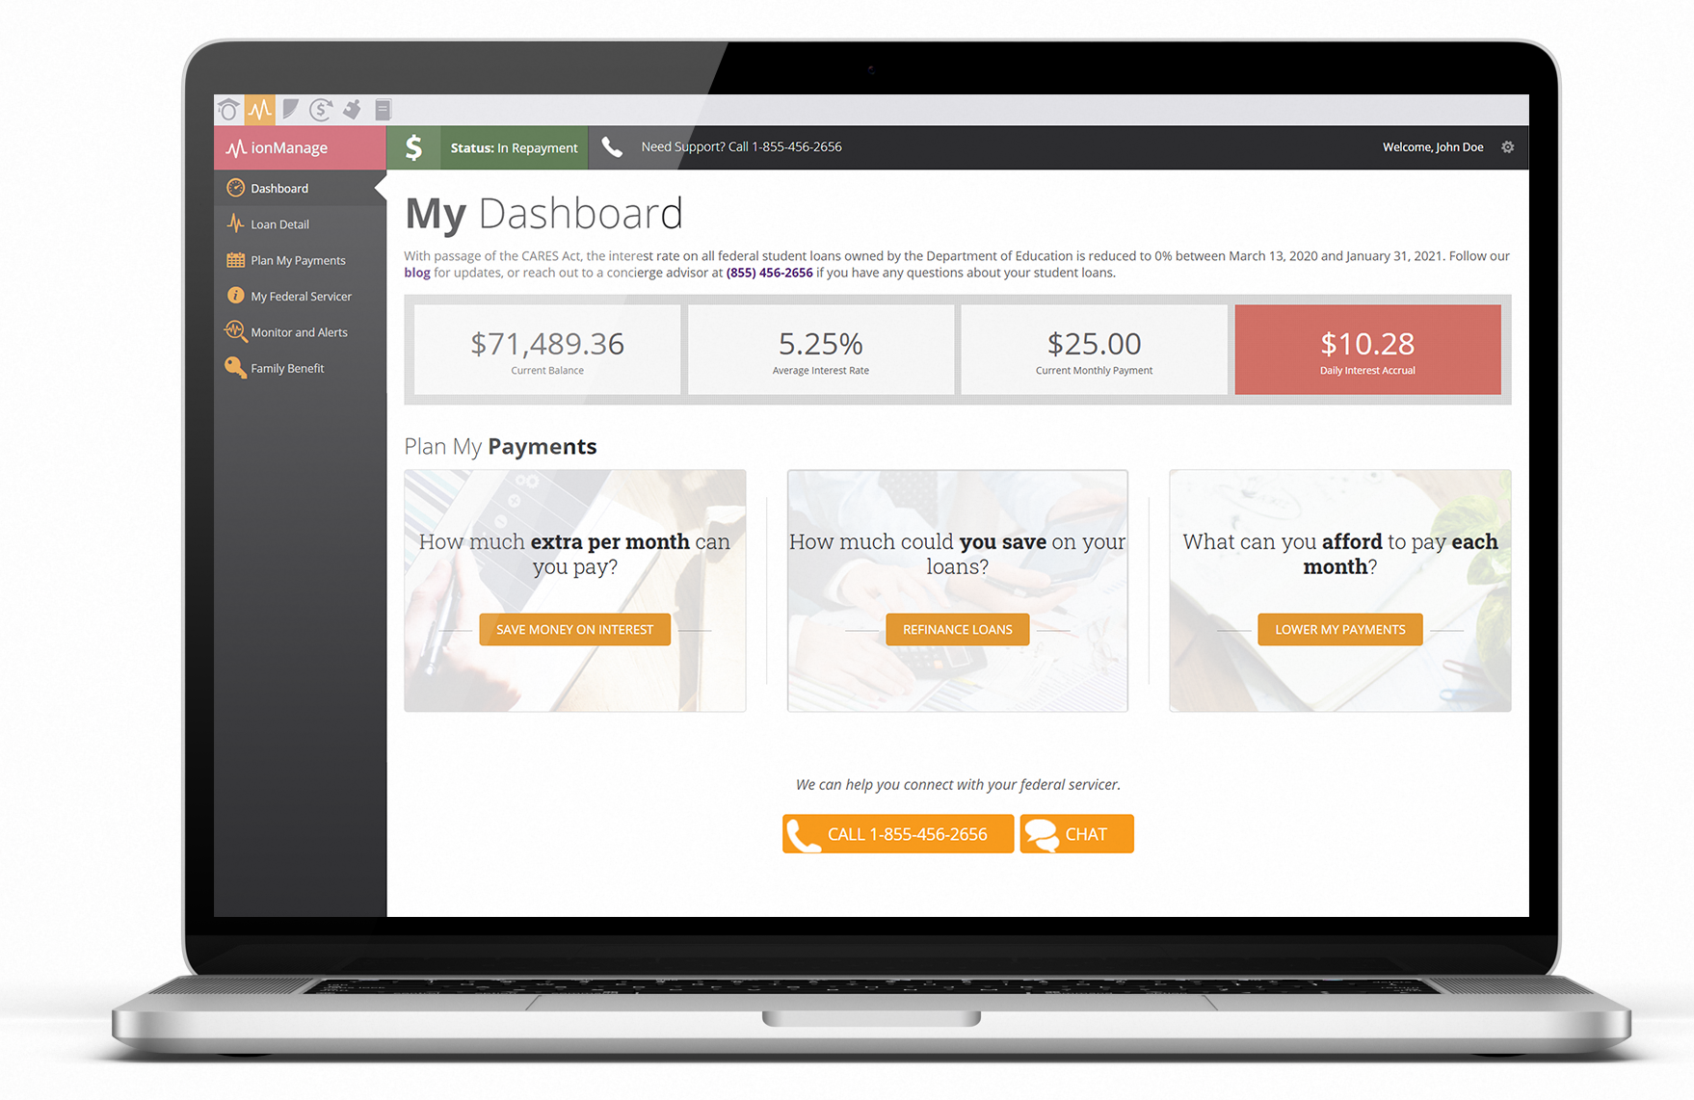

Streamlined Dashboard
View all federal student loans across all historical institutions in one dashboard. Loans are imported automatically through their servicer.
Each borrower receives an IonTuition account at no cost
Up-to-date, Aggregated Loan Information
Scenario-based Repayment Calculators
Loan Monitoring and Alerts
Family Benefit

Slide 9
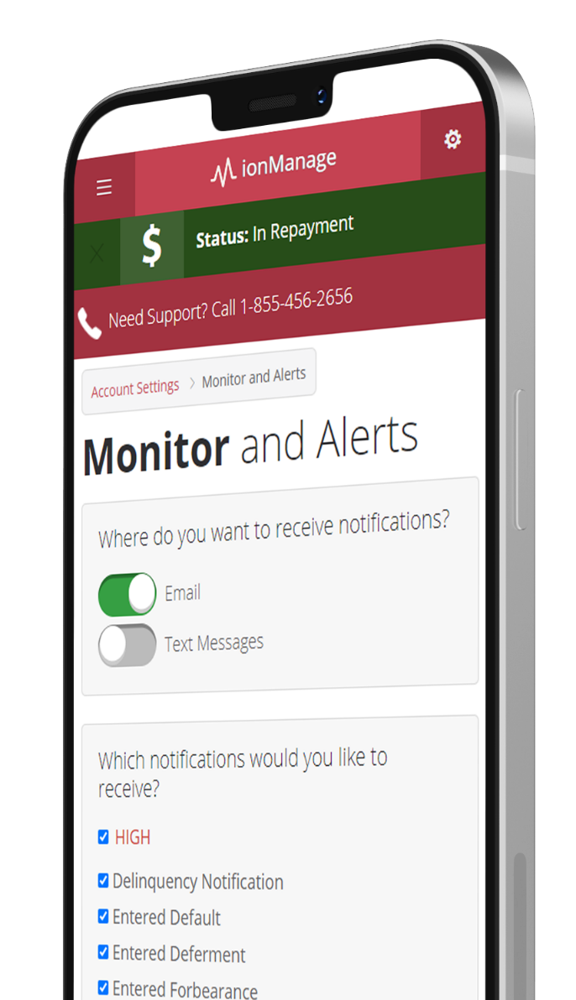
Monitor and Alerts
Receive custom notifications on your loans
Stay on top of repayment including delinquency, default and IDR recertification
Emails/SMS
Only receive relevant alerts
We set the borrower up for the future success after resolving their issue!

Slide 10

Trusted Help
IonTuition gives you access to concierge loan advisors.
Concierge advisors are available by phone & webchat
We set up a 3-way calling between the student and their Private Collection Agency/servicer.
We assist with repayment optimization
We help struggling students recover Title IV eligibility and avoid re-default

Slide 11

Unmatched Counseling Satisfaction
98% satisfaction rating based on our borrower experience surveys
Enroll double the amount of students into income-driven repayment plans compared to federal servicers
Overall satisfaction rating of 98%
Industry leading NPS Score

Slide 12


Brent Givens
Senior Vice President
847-873-2167 (M)
Bgivens@iontuition.com

